Slide 1
Cardiac Disease Prediction Using Machine Learning
Team Members:
Manav Rohilla – manav.2125cse1014@kiet.edu
Sukriti Rai – sukriti.2125cse1183@kiet.edu
- Parkhi Gupta – parkhi.2125ec1045@kiet.edu
- Guide: Ms. Nishu Gupta (Assistant Professor, CSE)
Institution: KIET Group of Institutions, Ghaziabad
PROJECT OUTCOME-
Research Paper
(accepted and submitted)

Slide 2
SDG MAPPING
SDG 3: Good Health and Well-being
Enhances emotional well-being of the community suffering with heart disease.
SDG 9: Industry, Innovation, and Infrastructure
Promotes AI-based innovation in assistive technology.
SDG 10: Reduced Inequalities
Empowers people with heart disease.
SDG 11: Sustainable Cities and Communities
Contributes to more inclusive and accessible environments.

Slide 3
Abstract
Objective: Explore the role of ML in enhancing CHD diagnosis using medical imaging datasets.
Feature Extraction Techniques :
GLCM (Gray Level Co-Occurrence Matrix)
HOG (Histogram of Oriented Gradients)
LBP (Local Binary Patterns)
ML Models Analysed : SVM, Decision Trees, Random Forest & XGBoost
Key Contribution: ML, particularly XGBoost, enables early and accurate CHD detection.

Slide 4
Introduction
What is CHD?
Structural heart abnormalities present at birth.
Includes septal defects, valve malformations, and complex structural anomalies.
Major contributor to infant morbidity and mortality.

Slide 5
Objective
- Revolutionize CHD diagnostics with ML-powered tools
- Minimize human error and provide solutions for resource-limited healthcare settings
- Automatically detects patterns & structural anomalies.

Slide 6
Dataset Description
Image CHD dataset : Comprises 110 3D Computed Tomography (CT) scans.
Scans acquired with a Siemens Biograph 64 machine.
Patient age: 1 month to 40 years, with most subjects between 1 month and 2 years.

Slide 7
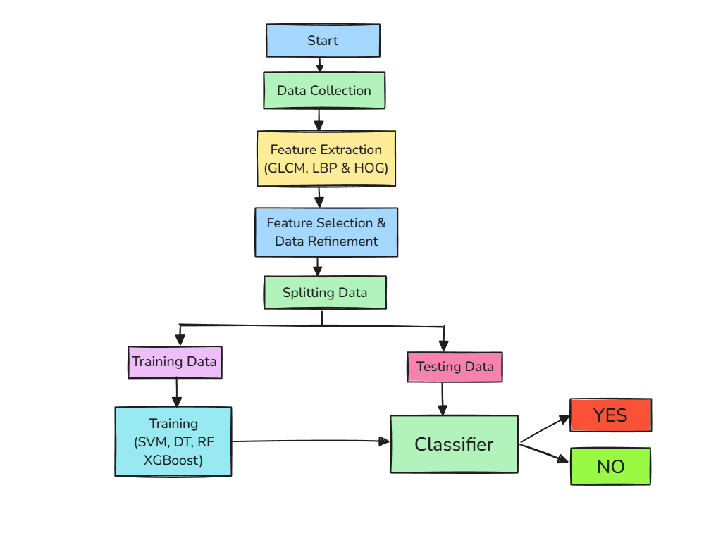
Methodology

Slide 8
Model Comparison – Technical
XGBoost (GLCM) – 87%
XGBoost (LBP) – 72%
SVM (HOG) - 72%

Slide 9
Evaluation Metrics
Accuracy
Precision
Recall
F1-Score

Slide 10
Results Summary
GLCM Based Performance:
XGBoost achieved the highest accuracy (87%), outperforming all models.
LBP-Based Performance:
- XGBoost led with 0.82 precision & 0.88 recall.
- Random Forest had a comparable F1 scores (0.79), showing robustness.
HOG-Based Performance:
Balanced performance across all models.
Decision Tree showed weaker metrics, likely due to limited feature interactions.

Slide 11
Conclusion
- Improved CHD Diagnosis: ML-based approach significantly improves accuracy and efficiency.
Best Model - XGBoost: Outperforms SVM, Decision Tree, and Random Forest in accuracy, precision, recall, and F1-score.
Advanced Feature Extraction: GLCM, HOG, and LBP improve model performance in detecting intricate cardiac patterns.

Slide 12
Thank You / Q&A
Thank you for your attention!
We welcome your questions.

